Slide 1
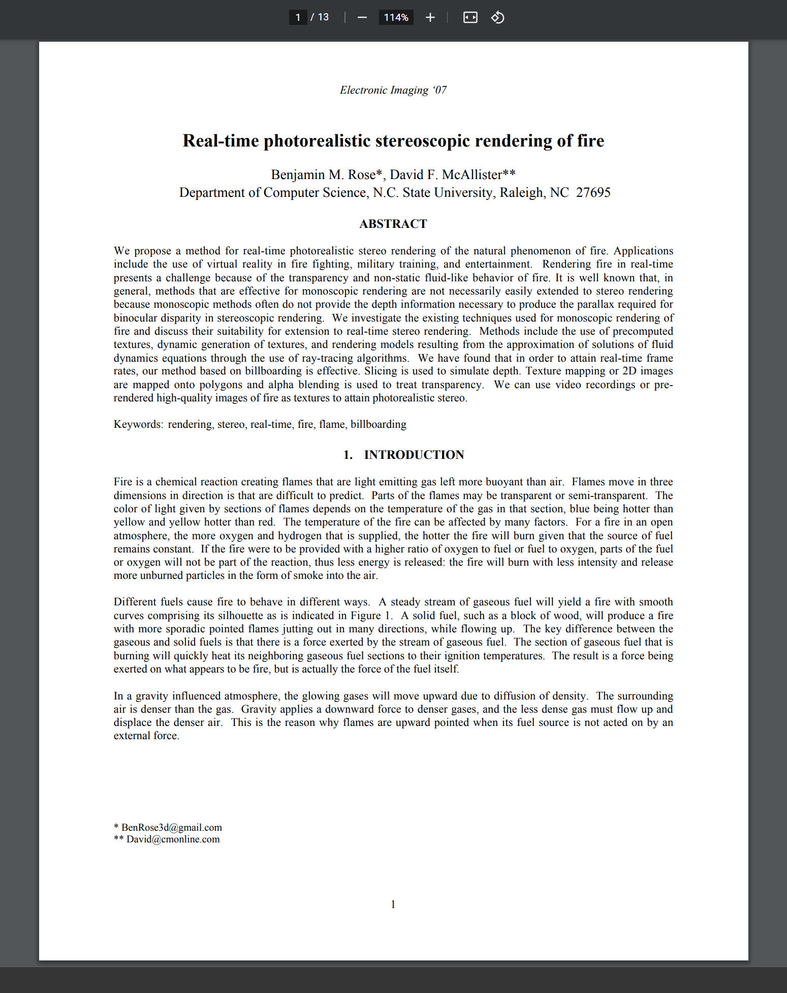

Real-Time Photorealistic Stereoscopic Rendering of Fire
Benjamin M. Rose and David F. McAllister
2007 Conference: Stereoscopic Displays and Virtual Reality Systems XIV
DOI : 10.1109/cad/graphics.2011.26

Slide 2
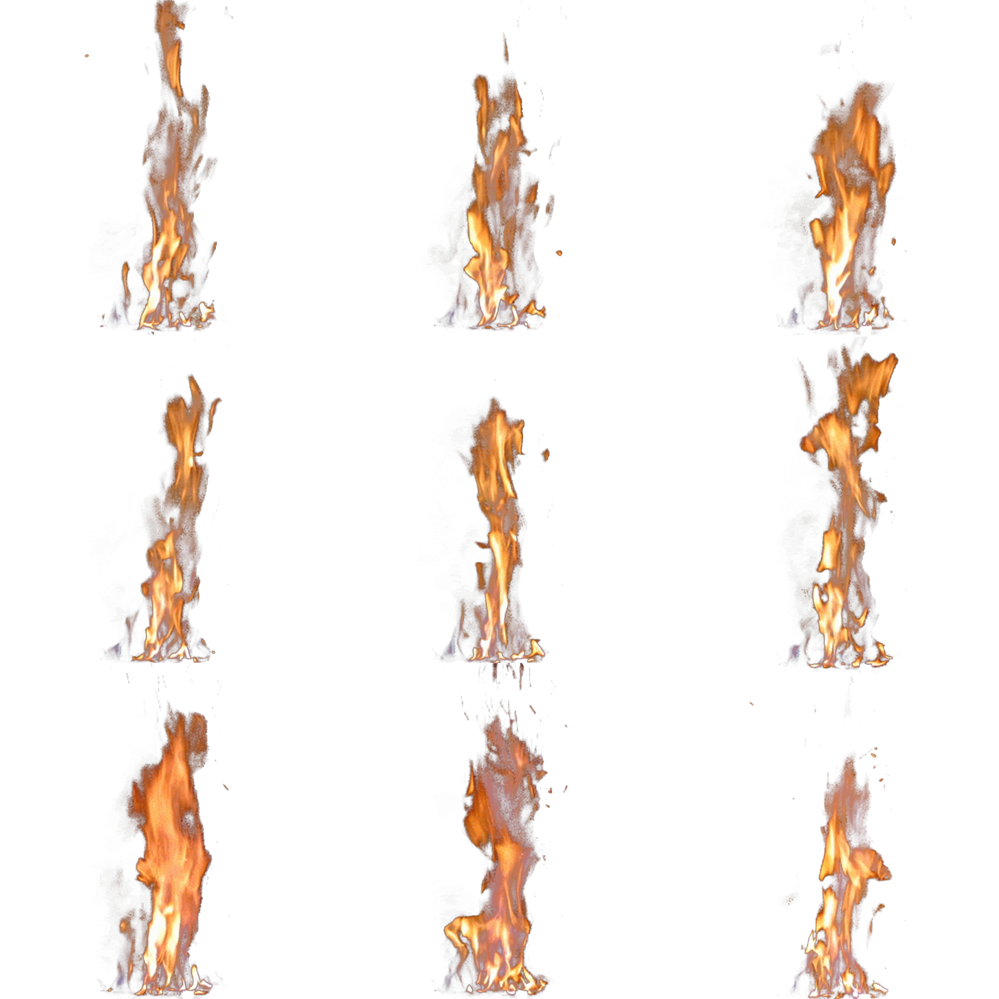
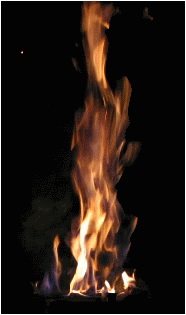
Texture Atlas

Slide 3
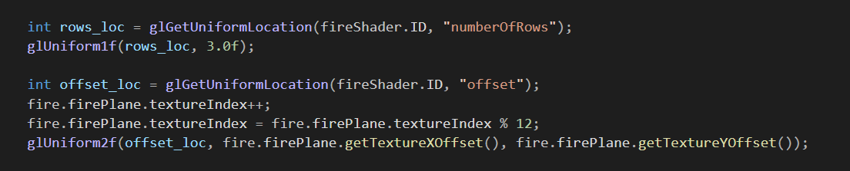
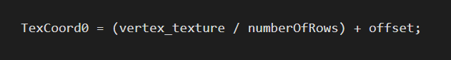
Texture Atlas Code
Vertex Shader Calculation:

Slide 4
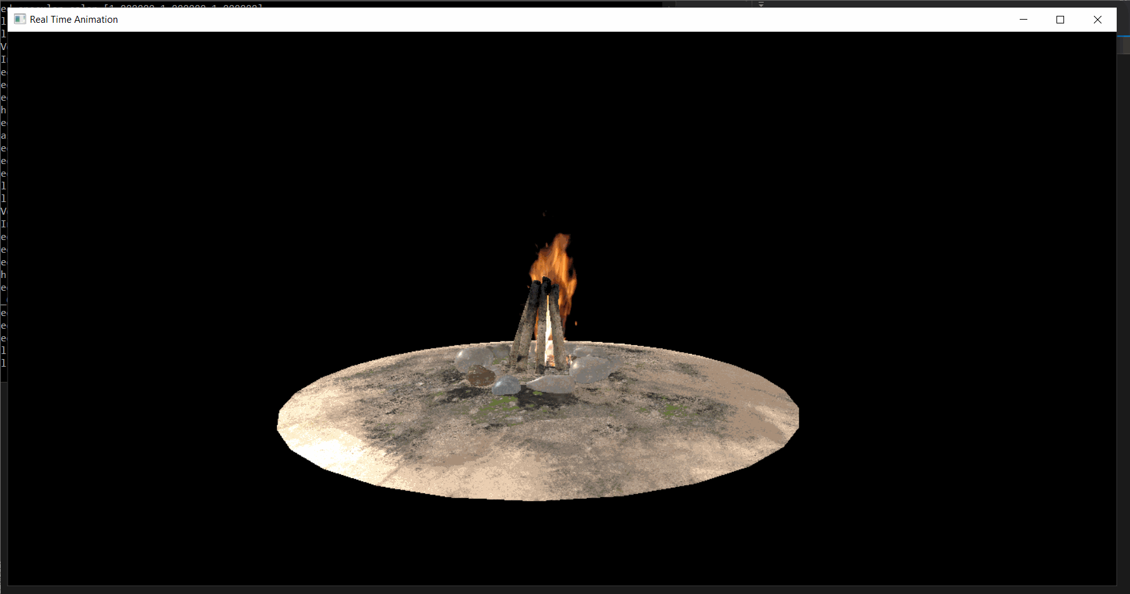

Slide 5
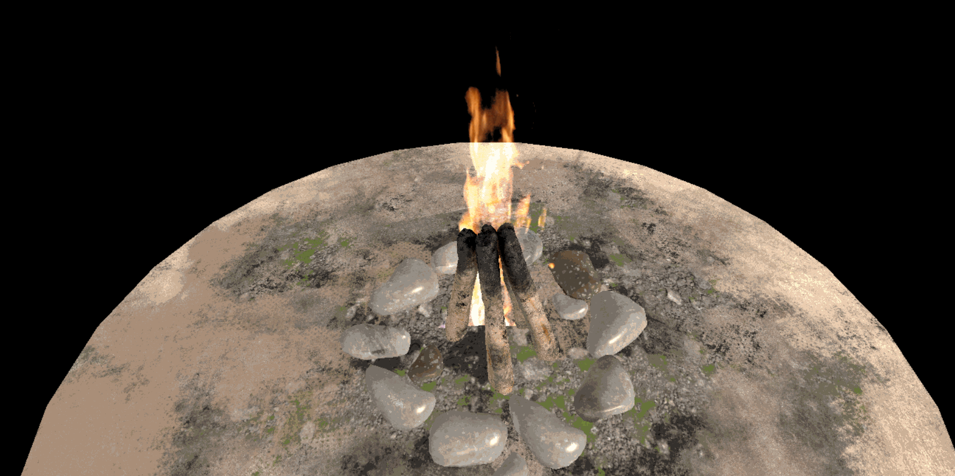
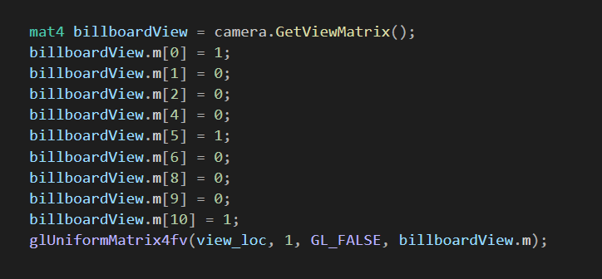
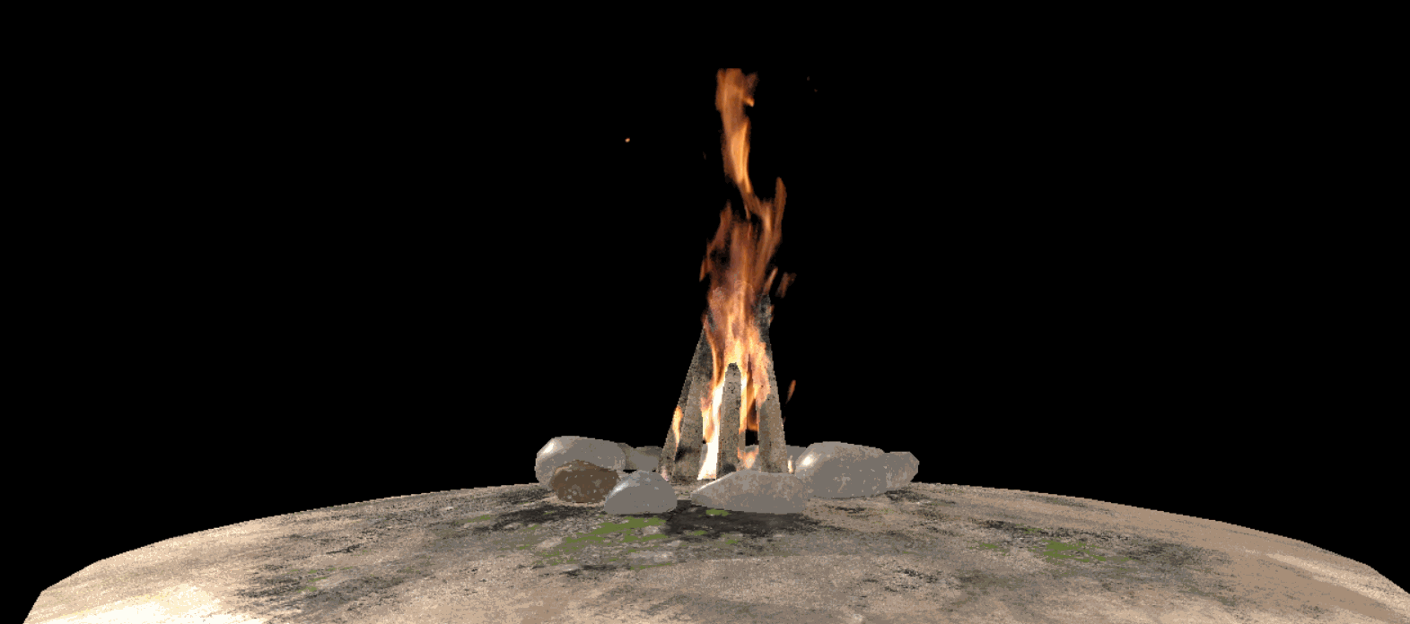
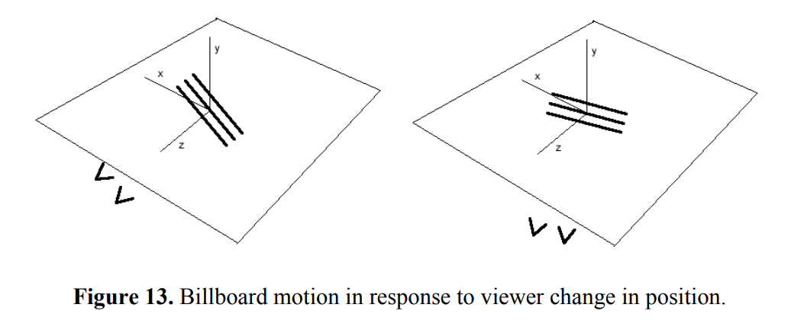
Billboarding Solution

Slide 6
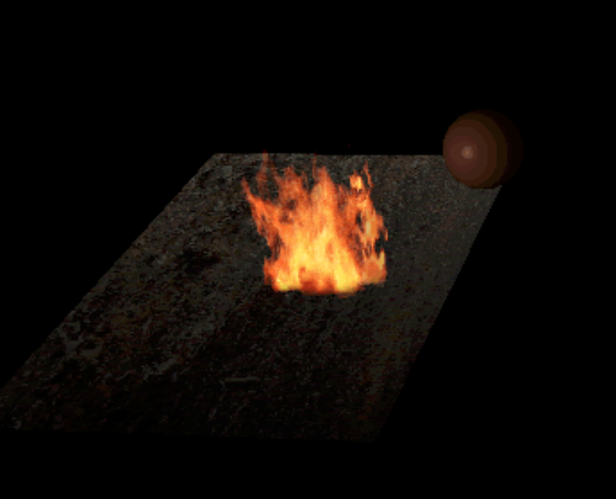
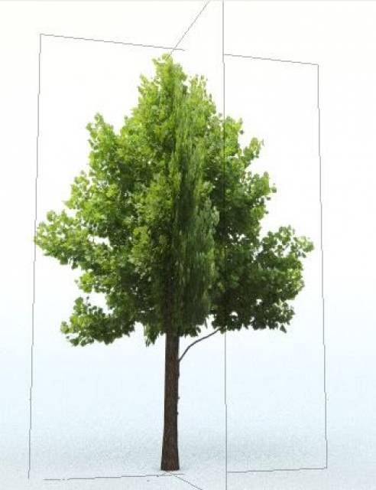
Future Work
Experiment with different versions of Billboarding
Add depth using several planes
Add Flickering Light
Add Billboarded smoke
Create comparison of different blending options

